Slide 1
Shane Parkes
Head of Technical Training and Delivery at North West Training Council
Notes:
Employed at N.W.T.C. for 23 years – worked my way up from Fab / Weld Instructor to Head of Technical Training and Delivery
Biggest change to training and since the introduction of NVQ’s in the 1990’s

Slide 2
Since 2009, we have trained and assessed Jaguar Land Rover apprentices – to date a total of 188 of which 30 are Higher Apprentices N.W.T.C. have a total of 395 engineering apprentices on our programmes
Notes:
We have been in business since the 1960’s

Slide 3
We are in the third year of delivering the Mechatronic Trailblazer Pathway and the first year of Tool and Die Trailblazer delivery We have 20 apprentices who started in 2015 with 23 2nd years including 14 toolmakers on the new Tool and Die Trailblazer Pathway and 19 3rd year apprentices Therefore, N.W.T.C. have experience and knowledge of the Trailblazer process
Notes:
And with knowledge comes power!!

Slide 4
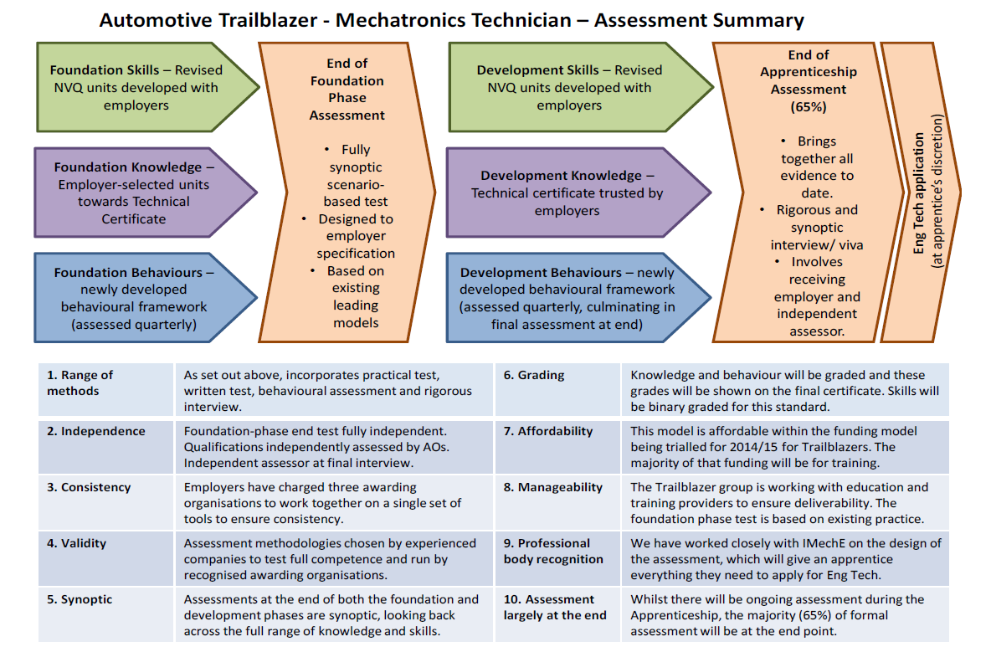
Notes:
Explain diagram – just talk through the stages

Slide 5
Workshop Delivery
The Foundation Units are based on the P.E.O. Level 2 units which we are all familiar with. A minimum of 1400 GLH for Level 2 Mechatronics covers the ten mandatory units being undertaken. This stage takes approximately 16 – 18 months(16 units JLR)
A substantial time off the job
The units selected gives the apprentices a broad based understanding of engineering skills. One of the four mandatory units along with health and safety includes business improvement techniques (BIT)
Notes:
GLH amount just shows how deep we have to go

Slide 6
The units JLR have chosen for their apprentices to undertake are:-
Producing components using hand fitting techniques
Maintaining mechanical devices and equipment
Assembling and testing fluid power systems
Maintaining electrical equipment and systems
Wiring and testing electrical equipment and circuits
Wiring and testing programmable controller based systems
Producing mechanical assemblies
Assembling and testing electronic circuits
Maintaining electronic equipment / systems
Preparing and using industrial robots
General turning, milling, welding applications
And four common core
Notes:
Just talk about the new ones – BIT, robotics, PLC etc..

Slide 7
Apprentices will then progress on to a more skill specific period of training; electronic maintenance, robotics, fluid power, assemblies and maintenance
In terms of CPD this means returning Instructors and Assessors to industry to familiarise themselves with technological developments and how to apply them within the assessment process in order to teach skill specific specialisation
Notes:
So talk about the impact this will have on the / your business. Assessor away from the work place etc..always needing to have their skills relevant and industry ready

Slide 8
Gateway Assessment (Practical)
This is also the point were the apprentices can fail the Foundation Stage due to their inability to apply the skill, knowledge and behaviours they have learned
The Assessment consists of a three day practical assessment covering at least three of the mandatory units (PL.C., elec. wiring and mech. maint.) they have undertaken with an emphasis on behaviour
We have just ran our second Gateway Assessment
Notes:
Go into a bit more detail about how Gateway Assessment went. Any surprises? Anything we hadn’t pre-empted?

Slide 9
F.E. Delivery
BTEC has 720 GLH attached
The BTEC framework is specific to the Trailblazer and has different rules and content to other BTEC qualifications
Be aware of timetabling issues; maintenance units should be taught after design units!
Notes:
Bit more content but don’t dwell – in terms of Mechatronics practical delivery is the priority!!!!

Slide 10
Behavioural Review This is an additional element to the qualification whereby implementing and maintaining the behavioural framework develops the apprentices holistically by including assessing personal skills and behaviours. Do not underestimate the time and training needed for staff to complete behavioural reviews
Behaviours
Knowledge
Skills
Notes:
Like mini psychological profiles

Slide 11
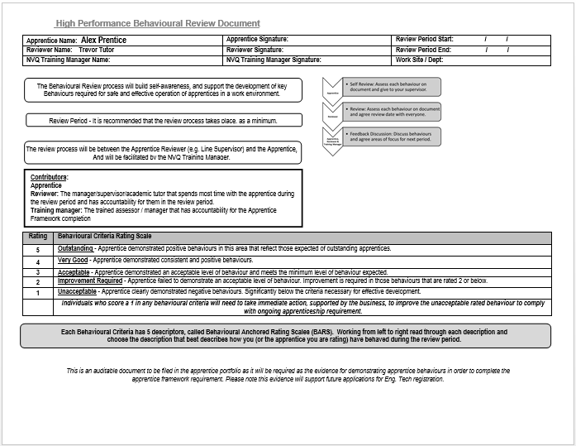
Notes:
An example - just chat about it – explaining scores briefly

Slide 12
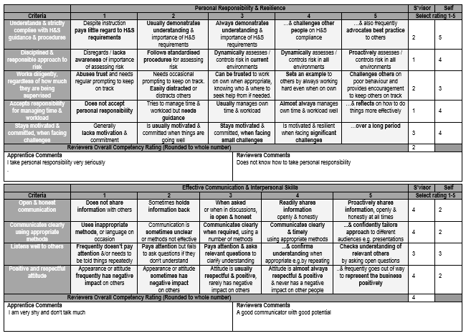
Notes:
Keep chatting about it – discuss grading –discuss example

Slide 13
Notes:
Example of a Workshop assessment document – THE BEHAVIOURS ARE IMPLEMENTED IN ALL ASSESSMENT PAPERWORK– first 7 points are the same on all!!

Slide 14
New Standards Financial Implications
Gain employer sign-off on the delivery cost model as early as possible - need to breakdown into training and assessment costs, payment profiles and split over the apprentice duration
Watch your cash flow remember you get no SFA income until you can evidence employer payment! However, currently rules allow you to skew payments to recover initial delivery costs
Ensure your MIS system can accommodate trailblazer funding - not sure about reconciliations
Watch for the impact of higher funding levels on your SFA contract allocation – especially ASB
Employer incentive payments come out of providers contract allocation -
Two payments for 16 -18 yr. olds - first after three months second after 12 months on programme – band 5 - £2,700 x 2
Payment for small business triggered after three months on programme - band 5 - £2,700
Need to establish a mechanism to pass these payments on the employer with a sufficient audit trail (payments should be made within 10 days)
Funding post 2017 unclear - so proceeding at risk re investment
Notes:
Just chat a bit about financial implications but say it is self explanatory

Slide 15
Fiscally, this programme is matched by the S.F.A.; every £2 the employer contributes, the government contributes £1 The costings which are agreed initially include delivery of training, assessment and the final synoptic test N.W.T.C. have employed a ‘Strategic Account Coordinator’ to explain and negotiate payment plans for the new standards So this wage is in addition to training courses for current staff, new equipment and consumables However, we have been recompensed already by the new business this has generated as other employers wish to follow this model. As a training organisation we have been re-energised by consistently evolving our instructional practices and of course it gives N.W.T.C. kudos to be a ‘Trailblazer ‘at the forefront of industry and governmental revolutionary change
Notes:
Talk about what / who it has brought in and what we expect for the future

Slide 16
Implications
Size of off the job period – Foundation Stage will take up to 18 months or 2 years to complete which will include the Gateway Assessment( 12 months for Tool and Die – 10 units)
Delivery Plan and associated logistics
Assessors do not interface with the second tier of apprentices employer i.e. managers, H.R.
Fiscal pressure such as the buying of new kit is a consideration as to date N.W.T.C have spent in the region of 250k on consumables
Notes:
You know it’s been a challenge and I have had many sleepless nights hahaha!!

Slide 17
Analysing behaviours has been protracted and convoluted as the detail is comparable to ‘profiling’. Staff expectations have not always matched the self appraised grade of the apprentice
The employer feels ownership towards the qualification and it is them not the Awarding Body who guides delivery and assessment.
N.W.T.C are only dealing with one employer, it would be very difficult therefore to administrate successfully to a number of customers
On a personal level, weekly meetings at JLR to communicate changes is time consuming meaning less time to embed the programme.
Notes:
Just chat about what a demanding qualification it is but this could be because it is ‘early days’ and it may calm down…….

Slide 18
Any questions?

